Slide 1
BIA 650 – Process Optimization and Analytics
1. Processes & Productivity
Part I - Background
Introduction to BIA 650 Course
Brief History of Data
Productivity
Modeling
Stakeholder Analysis
Part II – Operations in Excel
Matrix Operations
Data Manipulation – Pivot Operation
© E. A. Stohr, 2020

Slide 2
History: Technology Waves
Electronic Commerce
Hype
Cumulative IT Value
BIG DATA
Value
Data
Processing
MIS
Decision
Support
Systems
Expert
Systems
Business
Process
Reengineering
Business Intelligence
Social Networks
IOT
TQM
Knowledge Management
Blockchain
Cloud
© E. A. Stohr, 2013
Notes:
What’s good and bad in all of the management fads we have witnessed?
Each movement is a product of its time.
My answer is that each successive fad gets a lot of hype and then disillusionment sets in. But, there is a residual value in all of these movements - part of the truth (just not all of it)
Knowledge Management may last longer than the others?
Technology has two impacts (1st order and 2nd order effects):
1. Efficiency
2. It changes the social order - e.g. e-mail

Slide 3
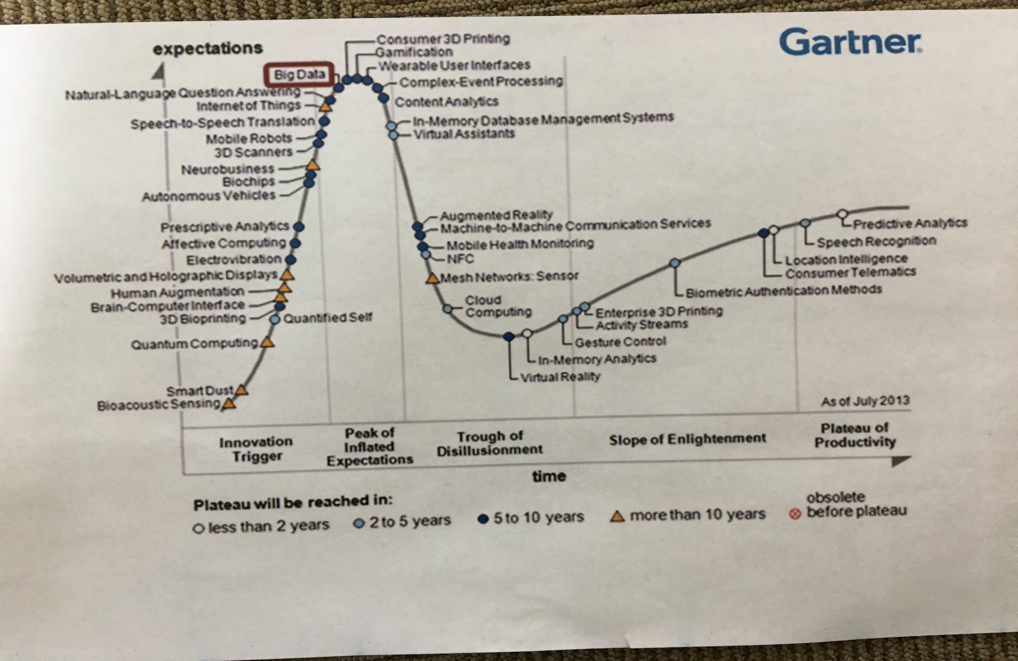
Gartner Hype Curve

Slide 4
A Brief History of Data

Slide 5
Data Management History
1950’s: Individual files, proprietary formats
1960’s: COBOL becomes standard business process language
      “Data division” in program used to define individual files
1960’s: Database management systems introduced. Data defined and managed independent of the application programs that used it.
1969: Introduction of the Relational database model (Codd). Theoretically derived concepts of “normalization” to reduce redundancy and update and delete “anomolies”
1970’s: Widespread adoption of the relational model for operational processing
1980’s: Data warehouses: Large repositories of an organization’s data. Data from extracted, transformed and loaded (ETL) from operational database into the data warehouse. Formatted in a “Star Schema” (non-normalized ) for optimal querying.
1990’s: Data mining and Knowledge Discovery in Databases (KDD) – discovering patterns in data.
2000’s: Explosion of data: business transactions on web and in social networks such as twitter and facebook.
-- EXTRACTING MEANING FROM DATA IS THE MAIN CHALLENGE

Slide 6
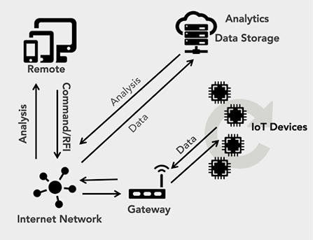
Data Management History (ctd)
Internet of Things (Gartner)
Internet-connected objects able to collect and exchange data using embedded sensors: 25 billion smartphones, tablets, PCs, smartwatches, connected TVs, surveillance devices, household appliances, medical devices, wearables.
Cognitive Computing
Big Data: improved decision capabilities afforded by broad and cheap access to very large data sets & new statistical and machine learning
Cognitive Computing: technologies that simulate and augment human decision making capabilities and have the ability to learn from experience.
Embedded Analytics
Embedding analytic models real time in business processes. Corporate dashboards, call centers, mobile devices, logistics, etc.
-- WHAT IS THE MAIN CHALLENGE NOW?

Slide 7
Big Data (http://www.whatsabyte.com/
1 Bit = Binary Digit
8 Bits = 1 Byte
1024 Bytes = 1 Kilobyte
1024 Kilobytes = 1 Megabyte
1024 Megabytes = 1 Gigabyte
1024 Gigabytes = 1 Terabyte
1024 Terabytes = 1 Petabyte
1024 Petabytes = 1 Exabyte
1024 Exabytes = 1 Zettabyte
1024 Zettabytes = 1 Yottabyte
1024 Yottabytes = 1 Brontobyte
1024 Brontobytes = 1 Geopbyte
Notes:
Megabytes, Gigabytes, Terabytes... What Are They?
These terms are usually used in the world of computing to describe disk space, or data storage space, and system memory. For instance, just a few years ago we were describing hard drive space using the term Megabytes. Today, Gigabytes is the most common term being used to describe the size of a hard drive. In the not so distant future, Terabyte will be a common term. But what are they? This is where it gets quite confusing because there are at least three accepted definitions of each term.
According to the IBM Dictionary of computing, when used to describe disk storage capacity, a megabyte is 1,000,000 bytes in decimal notation. But when the term megabyte is used for real and virtual storage, and channel volume, 2 to the 20th power or 1,048,576 bytes is the appropriate notation. According to the Microsoft Press Computer Dictionary, a megabyte means either 1,000,000 bytes or 1,048,576 bytes. According to Eric S. Raymond in The New Hacker's Dictionary, a megabyte is always 1,048,576 bytes on the argument that bytes should naturally be computed in powers of two. So which definition do most people conform to?
When referring to a megabyte for disk storage, the hard drive manufacturers use the standard that a megabyte is 1,000,000 bytes. This means that when you buy an 80 Gigabyte Hard drive you will get a total of 80,000,000,000 bytes of available storage. This is where it gets confusing because Windows uses the 1,048,576 byte rule so when you look at the Windows drive properties an 80 Gigabyte drive will report a capacity of 74.56 Gigabytes and a 250 Gigabyte drive will only yield 232 Gigabytes of available storage space. Anybody confused yet? With three accepted definitions, there will always be some confusion so I will try to simplify the definitions a little.
The 1000 can be replaced with 1024 and still be correct using the other acceptable standards. Both of these standards are correct depending on what type of storage you are referring

Slide 8
Big Data
Bit: A Bit is the smallest unit of data that a computer uses. It can be used to represent two states of information, such as Yes or No.
Byte: A Byte is equal to 8 Bits. A Byte can represent 256 states of information, for example, numbers or a combination of numbers and letters. 1 Byte could be equal to one character. 10 Bytes could be equal to a word. 100 Bytes would equal an average sentence.
Kilobyte: A Kilobyte is approximately 1,000 Bytes, actually 1,024 Bytes depending on which definition is used. 1 Kilobyte would be equal to this paragraph you are reading, whereas 100 Kilobytes would equal an entire page.
Megabyte: A Megabyte is approximately 1,000 Kilobytes. In the early days of computing, a Megabyte was considered to be a large amount of data. These days with a 500 Gigabyte hard drive on a computer being common, a Megabyte doesn't seem like much anymore. One of those old 3-1/2 inch floppy disks can hold 1.44 Megabytes or the equivalent of a small book. 100 Megabytes might hold a couple volumes of Encyclopedias. 600 Megabytes is about the amount of data that will fit on a CD-ROM disk.
Gigabyte: A Gigabyte is approximately 1,000 Megabytes. A Gigabyte is still a very common term used these days when referring to disk space or drive storage. 1 Gigabyte of data is almost twice the amount of data that a CD-ROM can hold. But it's about one thousand times the capacity of a 3-1/2 floppy disk. 1 Gigabyte could hold the contents of about 10 yards of books on a shelf. 100 Gigabytes could hold the entire library floor of academic journals.
Terabyte: A Terabyte is approximately one trillion bytes, or 1,000 Gigabytes. There was a time that I never thought I would see a 1 Terabyte hard drive, now one and two terabyte drives are the normal specs for many new computers. To put it in some perspective, a Terabyte could hold about 3.6 million 300 Kilobyte images or maybe about 300 hours of good quality video. A Terabyte could hold 1,000 copies of the Encyclopedia Britannica. Ten Terabytes could hold the printed collection of the Library of Congress. That's a lot of data.

Slide 9
Big Data (cont’d)
Petabyte: A Petabyte is approximately 1,000 Terabytes or one million Gigabytes. It's hard to visualize what a Petabyte could hold. 1 Petabyte could hold approximately 20 million 4-door filing cabinets full of text. It could hold 500 billion pages of standard printed text. It would take about 500 million floppy disks to store the same amount of data.
Exabyte: An Exabyte is approximately 1,000 Petabytes. Another way to look at it is that an Exabyte is approximately one quintillion bytes or one billion Gigabytes. There is not much to compare an Exabyte to. It has been said that 5 Exabytes would be equal to all of the words ever spoken by mankind.
Zettabyte: A Zettabyte is approximately 1,000 Exabytes. There is nothing to compare a Zettabyte to but to say that it would take a whole lot of ones and zeroes to fill it up.
Yottabyte: A Yottabyte is approximately 1,000 Zettabytes. It would take approximately 11 trillion years to download a Yottabyte file from the Internet using high-power broadband. You can compare it to the World Wide Web as the entire Internet almost takes up about a Yottabyte.
Brontobyte: A Brontobyte is (you guessed it) approximately 1,000 Yottabytes. The only thing there is to say about a Brontobyte is that it is a 1 followed by 27 zeroes!
Geopbyte: A Geopbyte is about 1000 Brontobytes! Not sure why this term was created. It is doubtful if anyone alive today will ever see a Geopbyte hard drive. One way of looking at a geopbyte is 15267 6504600 2283229 4012496 7031205 376 bytes!

Slide 10
BIG DATA (cont’d)
Too big for normal data storage and processing techniques to be viable.
Volume: Algorithms are not fast or efficient enough to process very large data sets: capacity is still finite
Velocity: Velocity refers to the speed requirement for collecting, processing, and using the data. Real-time needs (such as national security or the health of a child) are common.)
Variety: Multiple data types—structured, text, audio, video, and image data. Heterogeneous data form different sources need to be integrated.

Slide 11
Changes in Perspective
Flows (rather than Stocks) become important:
Real time fraud detection; sensor data; traffic management
Process monitoring/mining: detect changes in a supply chain
Exploring/exploiting network relationships: friends on twitter, social network analytics to detect changes in consumer sentiment

Slide 12
Data Warehousing: Process
MIS 630
MIS 636
History of Sales & Production
Area Data
Current Data
Marketing
Transaction
Database
Data Warehouse
Sales
Production
Online Transaction Processing (OLTP)
Online Analytical Processing (OLAP)
Build Data Warehouse
Build Data Marts
Design
Map
Extract
Scrub
Transform
Load
Index
Extract
Replicate
Access
Analyze

Slide 13
Data Mining Process
Data Mining: The process of analyzing large data bases to discover useful patterns and rules
MIS 637
Step 1: Data Mining
Selected
data
Business rules
Extract of Transaction
data
Data Mining Software
Business
Expert
Data warehouse
Manual check & validation
New Knowledge! Beer and diapers on Fridays!
Step 2: Action ???
Step 3: Analyze results; feedback to data warehouse

Slide 14
PRODUCTIVITY AND EFFICIENCY
Raising the productivity of knowledge workers is the
greatest challenge facing management and raising the
productivity of service workers and knowledge workers
is the greatest challenge facing society (Peter Drucker)

Slide 15
Knowledge & Service Work
Definition and Breakdown
Services are consumed as they are produced. There is often a direct encounter between the provider and the consumer.
Business services: Consulting, finance, banking
Trade services: Retailing, maintenance and repair
Infrastructure services: Communications, transportation
Social/personal services: Restaurants, health care
Public administration: Education, government
Another view of services:
70% Knowledge work: Professional/technical; Managers; Officials; Proprietors; Clerical; Sales; Educators
30% Other services: Private household workers; other

Slide 16
Work Force Trends
Fitzsimmons & Fitzsimmons, Service Management for Competitive Advantage, McGraw-Hill,1993
Composition of the Work Force
Agricultural workers - 2%
Factory workers - 18%
Information workers - 45%
Knowledge workers - 12%
Other service workers - 23%
Over 75% of the work force is outside of manufacturing and agriculture.
A service is a time-perishable, intangible experience performed for a customer acting in the role of a co-producer. (FITZSIMMONS & FITZSIMMONS 2003).
Notes:
The extract below is from CIA World Factbook (2006):
farming, forestry, and fishing 0.7%,
manufacturing, extraction, transportation, and crafts 22.9%,
managerial, professional, and technical 34.7%,
sales and office 25.4%,
other services 16.3%
note: figures exclude the unemployed (2005)

Slide 17
Productivity Trends
Fitzsimmons & Fitzsimmons, Service Management for Competitive Advantage, McGraw-Hill,1993.
U.S. Productivity growth over the last 10 years:
Farming - 2.04% per annum
Manufacturing - 2.75%
Finance & real estate - 0.17 %
Wholesale and retail trade - 1.15 %
Productivity in service and knowledge work has historically been much lower than in farming, manufacturing and transportation.
There are signs of a turn-around in the last few years.
Is this due to IT? To TQM? To Reengineering?
The cost of a teller transaction at a bank is $1.07, the cost of a similar online banking transaction is one cent. The productivity literature in the last decade points to a virtually unanimous conclusion – information technology directly or indirectly accounts for the lion’s share of the resurgence of productivity in the United States since 1995.
Notes:
Latest U.S. Productivity Figures:
NYT “Notions of New Economy Hinge on the Pace of Growth” Sep 2001.
Overall productivity for 1999-2000 has been revised down (from 3.4% to 2.6%)
Productivity is the engine of economic growth without inflation and with full employment. The government is relying on this to finance the surplus.
NYT “Americans’ International Lead in Hours Worked”
Productivity growth slower in knowledge work?

Slide 18
Defining & Measuring Productivity
Productivity is an efficiency (rather than an effectiveness) concept.
Productivity = Output quantity/Input quantity= O/I
where O and I vary with the application. Examples:
GDP per person, value added per labor hour, etc.
Note that O and/or I can be multidimensional:
Productivity = O/(L + C + R + Q)
where L = labor, C = capital, R = raw materials and Q = miscellaneous goods and services. In this case, all of the inputs are in monetary terms.
Profitability can be related to productivity as follows:
Profitability = Productivity x Price recovery
= (O/I) x (P_{o}/P_{i})
where P_{o} = output price index, P_{i} = input price index
Notes:
Productivity doesn’t matter if you are not profitable?

Slide 19
Economist’s Viewpoint
Input Efficiency
The firm is optimally using the factors of production
Allocative Efficiency: Inputs are combined in optimal proportions
Technical Efficiency: No more of each input is used than should be required to produce a given level of output
Output Efficiency
The firm produces the correct combination & level of outputs.
Scale efficiency: The firm maximizes the ratio of outputs to inputs.
Scope efficiency: The firm jointly produces two or more outputs more efficiently than it could produce each of the outputs separately.
Notes:
Allocative Efficiency: Occurs when inputs are combined in optimal proportions e.g. an efficient high tech (capital intensive) firm uses a lot less labor than a low tech firm.
Scale efficiency: Occurs when a firm is operating at a level that maximizes the ratio of outputs to inputs.
If there are increasing returns to scale, then the firm should produce more (if the market allows) (and vice versa for decreasing returns). If we assume constant returns to scale, output efficiency and technical input efficiency coincide.
Scope efficiency: Occurs when the firm jointly produces two or more outputs more efficiently than it could producing each of the outputs separately.
Which efficiency is addressed by a merger with a similar firm?
Which efficiency does BPR address?
Which dot-com is using scope efficiency?
Are there any other ways in which a firm can become more efficient?

Slide 20
Introduction to Modeling

Slide 21
Stakeholder Analysis
Clients: People or groups who (should) benefit from the installation and operation of the system. (e.g., for the Howe School, clients could be current students, business, or both)
Objectives: Goals to be achieved or directions to be pursued that serve the interests of the clients. Sometimes these can be quite general. e.g., For student client, “maximize long term student earning potential,” for business, the objective might be “maximize students’ employable skills”)
Criteria: Objective measures of the goals and objectives. Measures of success or failure of the system (e.g., student starting salaries)
Decision Makers: People who run or operate the system or otherwise influence the achievement of the objectives. e.g., for Howe = faculty
The actions & reactions of clients & decision makers must be taken into account & both groups must be favorably influenced in order to achieve the goals of the system

Slide 22
Stakeholder Analysis - ctd.
Value Propositions: An account of the value provided to the various system stakeholders (e.g., For students, NYC location, strong faculty, ..)
System Vision: A short statement about the goals of the system, that can be used to inspire and guide future actions
Resources: Every system has limits on the time, land, labor and capital available for its development and deployment.
Constraints: What external/internal forces limit freedom of action? (e.g. Possible constraints: Adhere to government policies, space in NYC, meet a organizational deadline, etc.)
Critical Assumptions: Assumptions that are implicitly or explicitly made about the world which, if untrue, would have a major impact on the desirability of the project. (e.g. Traditional universities will survive in the Internet age)

Slide 23
Stakeholder Analysis - Process
Determine in order:
The clients (who benefits?)
The objectives of each client
The criteria by which attainment of the clients’ objectives can be measured
Make choices trading off the objectives of one client against another to determine the objectives of your project
Determine the decision makers – those who will control the success or failure of the projects
Develop value propositions for each stakeholder (clients and decision makers)
Determine constraints that will need to be overcome
Determine the resources that will be available
Examine critical assumptions

Slide 24
Model Purpose Classification
Descriptive
Understand what has happened
Tools: Data warehousing: Cognos, Tableau --- MIS 636
Predictive
Forecast what will happen
Tools: Statistics, Machine Learning --- BIA 652, MIS 637
Prescriptive
Decide what we should do
Tools: Optimization --- BIA 650

Slide 25
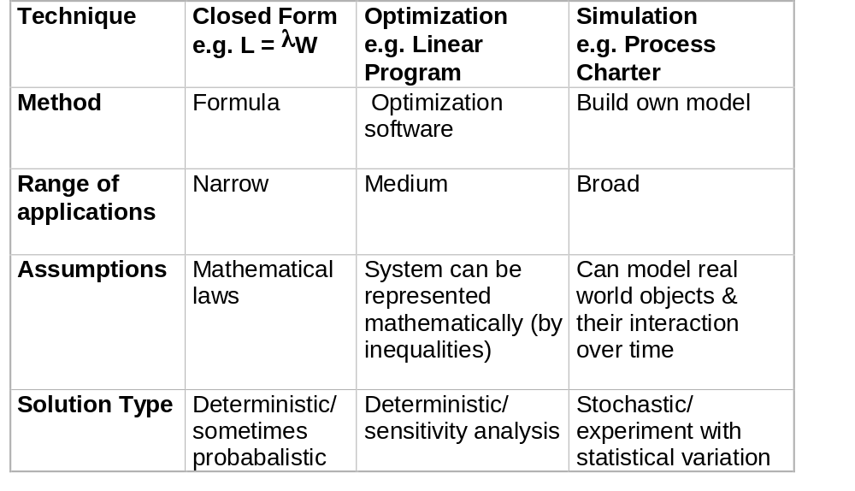
Types of Model

Slide 26
Models and the Real World
Inputs
Inputs
Uncertainty
Uncertainty
Real World
Model
Policies/
Decisions
Policies/
Decisions
Constraints
Constraints
Outputs
Outputs
Assumption: Behavior in the model will be reflected in real world behavior
Guarantors:
Non-stochastic models (Closed form and optimization) – sensitivity analysis – vary parameters and policies
Stochastic models (simulation) – experiment for each parameter and policy setting

Slide 27
Seven-Step Modeling Process
(From W&A Chapter 1)
  1. Problem Definition
  2. Data Collection
  3. Model Development
  4. Model Verification
  5. Optimization and Decision Making
  6. Model communication to Management
  7. Model implementation

Slide 28
Structure of W&A Homeworks
Two Parts – each worth 1 point
1. Management Overview (up to 1 page)
Problem Statement
Data Sources
Model approach
Solution & Sensitivity Analysis
Recommendations
2. Excel Spreadsheet
Identifiers: Your name, date, W&A Ch #, Problem #, Page #
Clearly annotated, use range names where appropriate
Inputs – blue cells
Decision Variables – red cells
Outputs – gray cells

Slide 29
Introduction to Excel

Slide 30
Matrix Operations in Excel
MATRIX MUTIPLICATION |  |  |  |  |  |  |  | MMULT
 | AMAT |  |  |  | BMAT |  |  | AMAT*BMAT
 | 5 | 4 | 3 |  | 1 | 2 |  | 10 | 13
 | 2 | 1 | 1 |  | 2 | 0 |  | 3 | 5
 |  |  |  |  | -1 | 1
MATRIX ADDITION AND SUBTRACTION
 | CMAT |  |  |  | DMAT |  |  | CMAT+DMAT |  |  | CMAT-DMAT
 | 1 | 0 |  |  | 2 | 2 |  | 3 | 2 |  | -1 | -2
 | 0 | 1 |  |  | 2 | 1 |  | 2 | 2 |  | -2 | 0
MATRIX INVERSE |  |  |  |  | MINVERSE
 | CMAT ⁻ ¹ |  |  |  | DMAT ⁻ ¹ |  |  | KVEC
 | 1 | 0 |  |  | -0.5 | 1 |  | 2
 | 0 | 1 |  |  | 1 | -1 |  | 1
SIMULTANEOUS EQUATIONS
 | DMAT.X = K |  | X
 | X = DMAT⁻¹*K |  | 0 |  |  |  |  | NAMED AREAS
 |  |  | 1 |  |  |  |  | AMAT | =Sheet1!$B$3:$D$4
 |  |  |  |  |  |  |  | BMAT | =Sheet1!$F$3:$G$5
MATRIX TRNSPOSITION |  |  |  |  |  |  |  | CMAT | =Sheet1!$B$8:$C$9
 | AMAT TRANSPOSE |  |  |  |  |  |  | DMAT | =Sheet1!$F$8:$G$9
 | 5 | 2 |  |  |  |  |  | DMAT_1 | =Sheet1!$F$12:$G$13
 | 4 | 1 |  |  |  |  |  | KVEC | =Sheet1!$I$12:$I$13
 | 3 | 1
Stripe area, enter matrix formula and press CTRL-SHIFT-ENTER

Slide 31
Pivot Operation in Excel
Many datasets come in the form of Excel files.
The ability to “Filter” and “Sort” the data are essential to understanding the data and discovering possible errors.
The “Pivot” operation in Excel allows one to “slice and dice” the data to produce many useful reports. Often, these different dimensional views also help to discover errors in the data.
DEMONSTRATION

